Slide 1
Module 9:Create a SharePoint Client Side Webpart

Slide 2
Module 9
Create a SharePoint Client Side Webpart
Setup development Environment
Learn Limitations
Develop Client Site webpart.
Deploy SPFx Webpart

Slide 3
What is SharePoint Framework (SPFx)
The SharePoint Framework (SPFx) is a page and web part model that provides full support for client-side SharePoint development, easy integration with SharePoint data, and support for open-source tooling. With the SharePoint Framework, you can use modern web technologies and tools in your preferred development environment to build productive experiences and apps that are responsive and mobile-ready from day one. The SharePoint Framework works for SharePoint Online and on-premises (SharePoint 2016 Feature Pack 2 and SharePoint 2019).
Historically, we created web parts as full trust C# assemblies that were installed on the cloud servers. However, current development models for the most part involve JavaScript running in a browser making REST API calls to the SharePoint and Office 365 back-end workloads. The SharePoint Framework is the next evolution in SharePoint development.

Slide 4
Key features of the SharePoint Framework
It runs in the context of the current user and connection in the browser. There are no iFrames for the customization (JavaScript is embedded directly to the page).
The controls are rendered in the normal page DOM.
The controls are responsive and accessible by nature.
It enables the developer to access the lifecycle in addition to render, load, serialize and deserialize, configuration changes, and more.
It is framework-agnostic. You can use any JavaScript framework that you like: React, Handlebars, Knockout, Angular, and more.
The toolchain is based on common open source client development tools such as npm, TypeScript, Yeoman, webpack, and gulp.
Performance is reliable.
End users can use SPFx client-side solutions that are approved by the tenant administrators (or their delegates) on all sites, including self-service team, group, or personal sites.
SPFx web parts can be added to both classic and modern pages.

Slide 5
SPFx Version History
SharePoint Framework is a new development model for building SharePoint customization. In the last three years, we have seen many number of releases for SharePoint Framework.
17 Feb 2017 - GA(1.0.0), 1.0.1, 1.0.2, 1.1.0, 1.1.1, 1.1.3, 1.2.0, 1.3.0, 1.3.1, 1.3.2, 1.3.4, 1.4.0, 1.4.1, 1.5.0, 1.5.1, 1.6.0, 1.7.0, 1.7.1, 1.8.0, 1.8.1, 1.8.2, 1.9.0, 1.9.1, 1.10.0, 1.11.0, 1.12.0,1.12.1, 1.13.0,1.13.1, 1.14.0, 1.15.0,1.16.0,1.17.0,1.18.0, 1.19.0
Aug 2016 - Drop 1, Drop 2, Drop 3, Drop 4, Drop 5, Drop 6, RC0
Always Microsoft recommend to use latest version, but in reality, it is very difficult to manage with team-based development, since we always don't upgrade to a new version.
Notes:
https://www.eliostruyf.com/sharepoint-framework-generator-changelog

Slide 6
SharePoint Server Support
SharePoint 2016 Feature Pack 2 supports SharePoint Framework v1.1.0
SharePoint 2019 supports SharePoint Framework v1.4.1

Slide 7
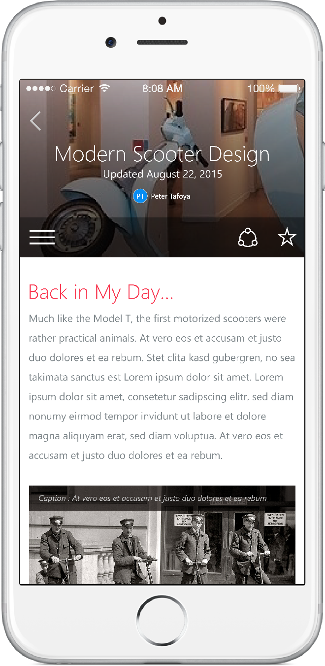
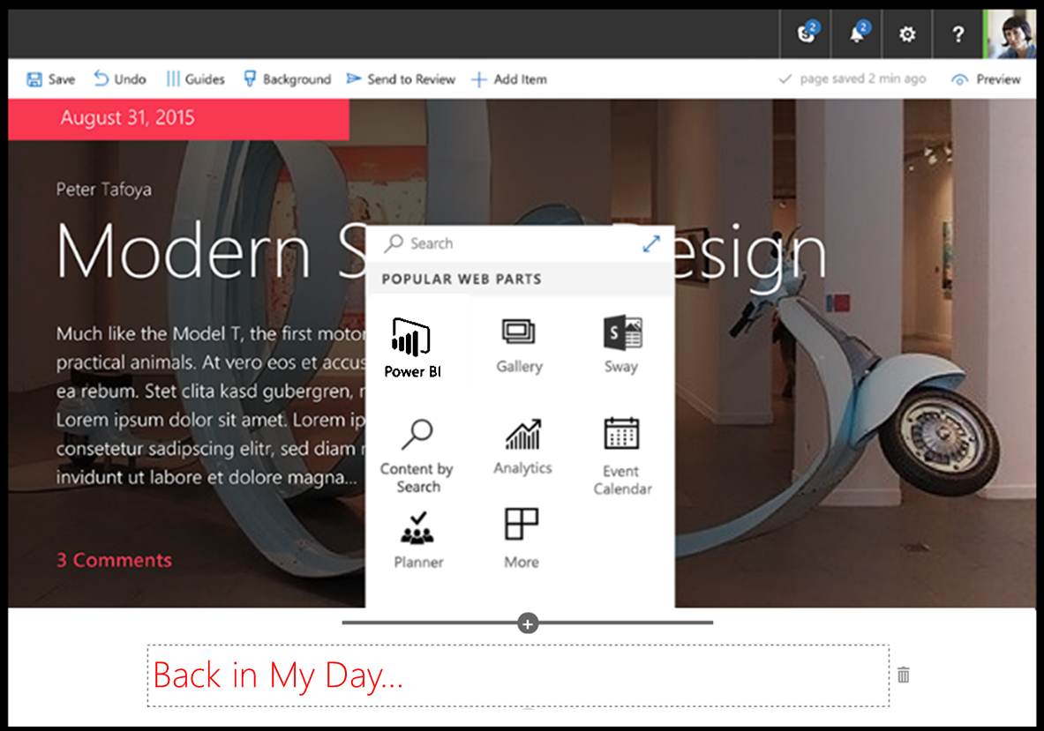
SharePoint Framework
Modern client-side development
Lightweight web and mobile
Powers our own experiences
Backward compatible
Supports open source tools & JavaScript web frameworks
SharePoint Framework
Microsoft Graph
LOB Systems and Cloud Services
Notes:
Built into the SharePoint mobile apps

Slide 8
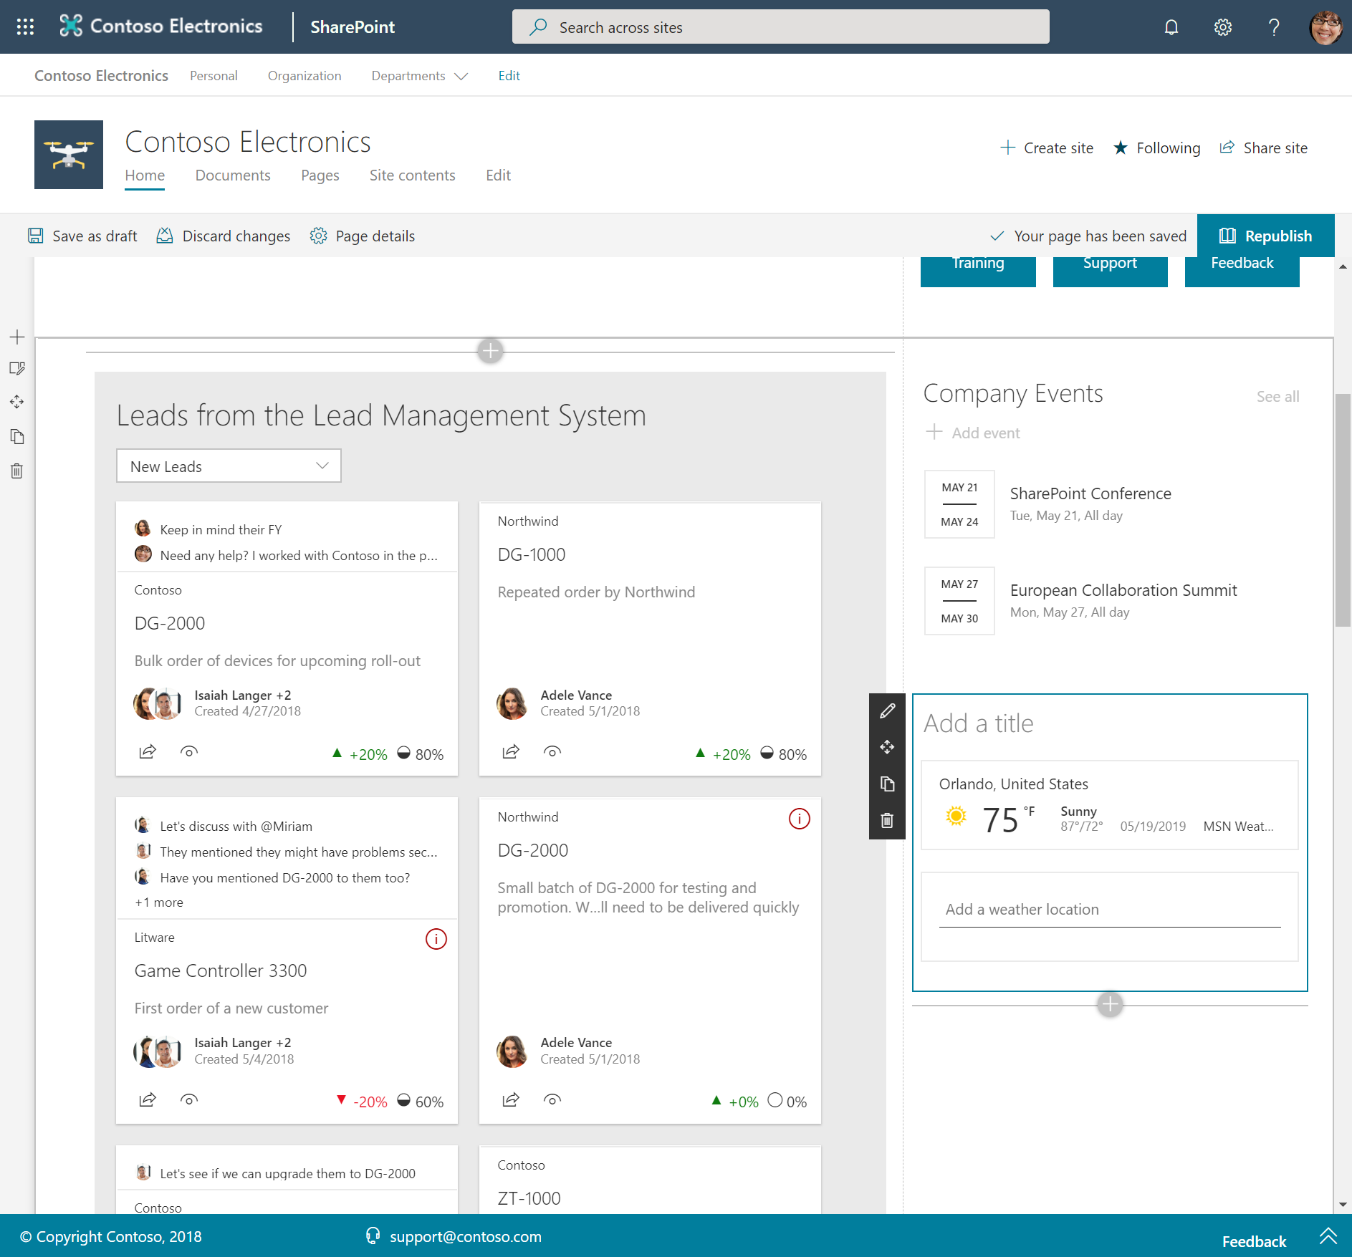
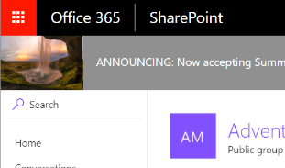
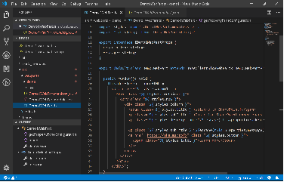
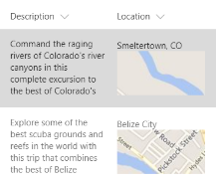
SharePoint Framework component types
Web Parts
Extensions
Libraries

Slide 9
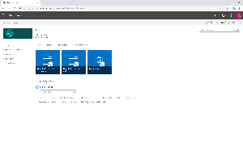
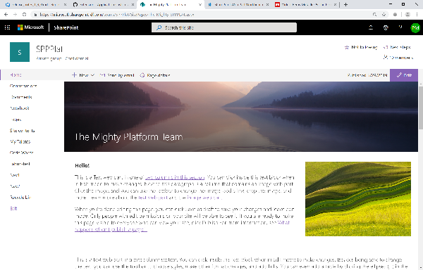
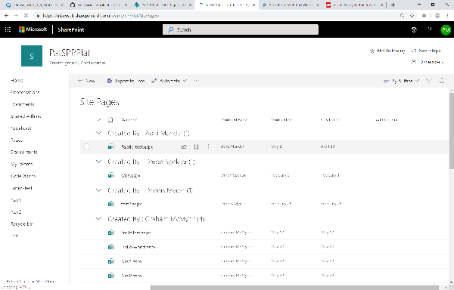
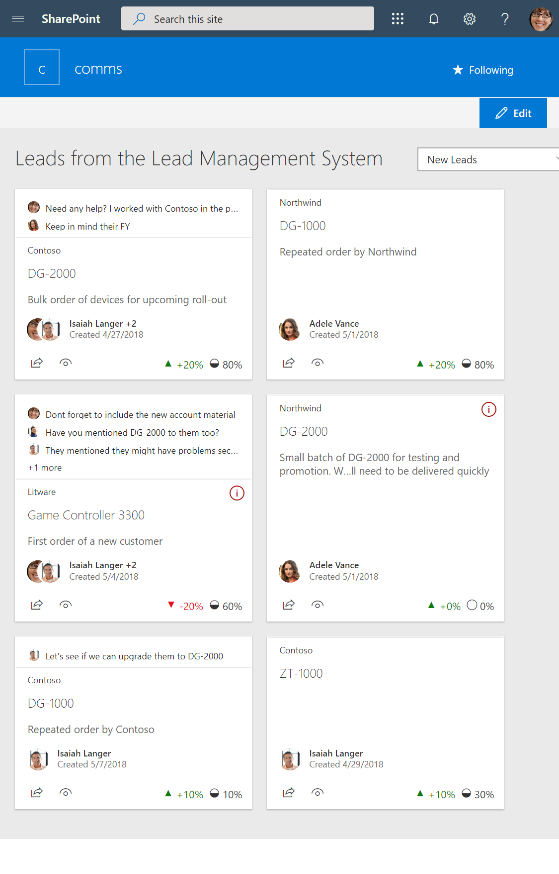
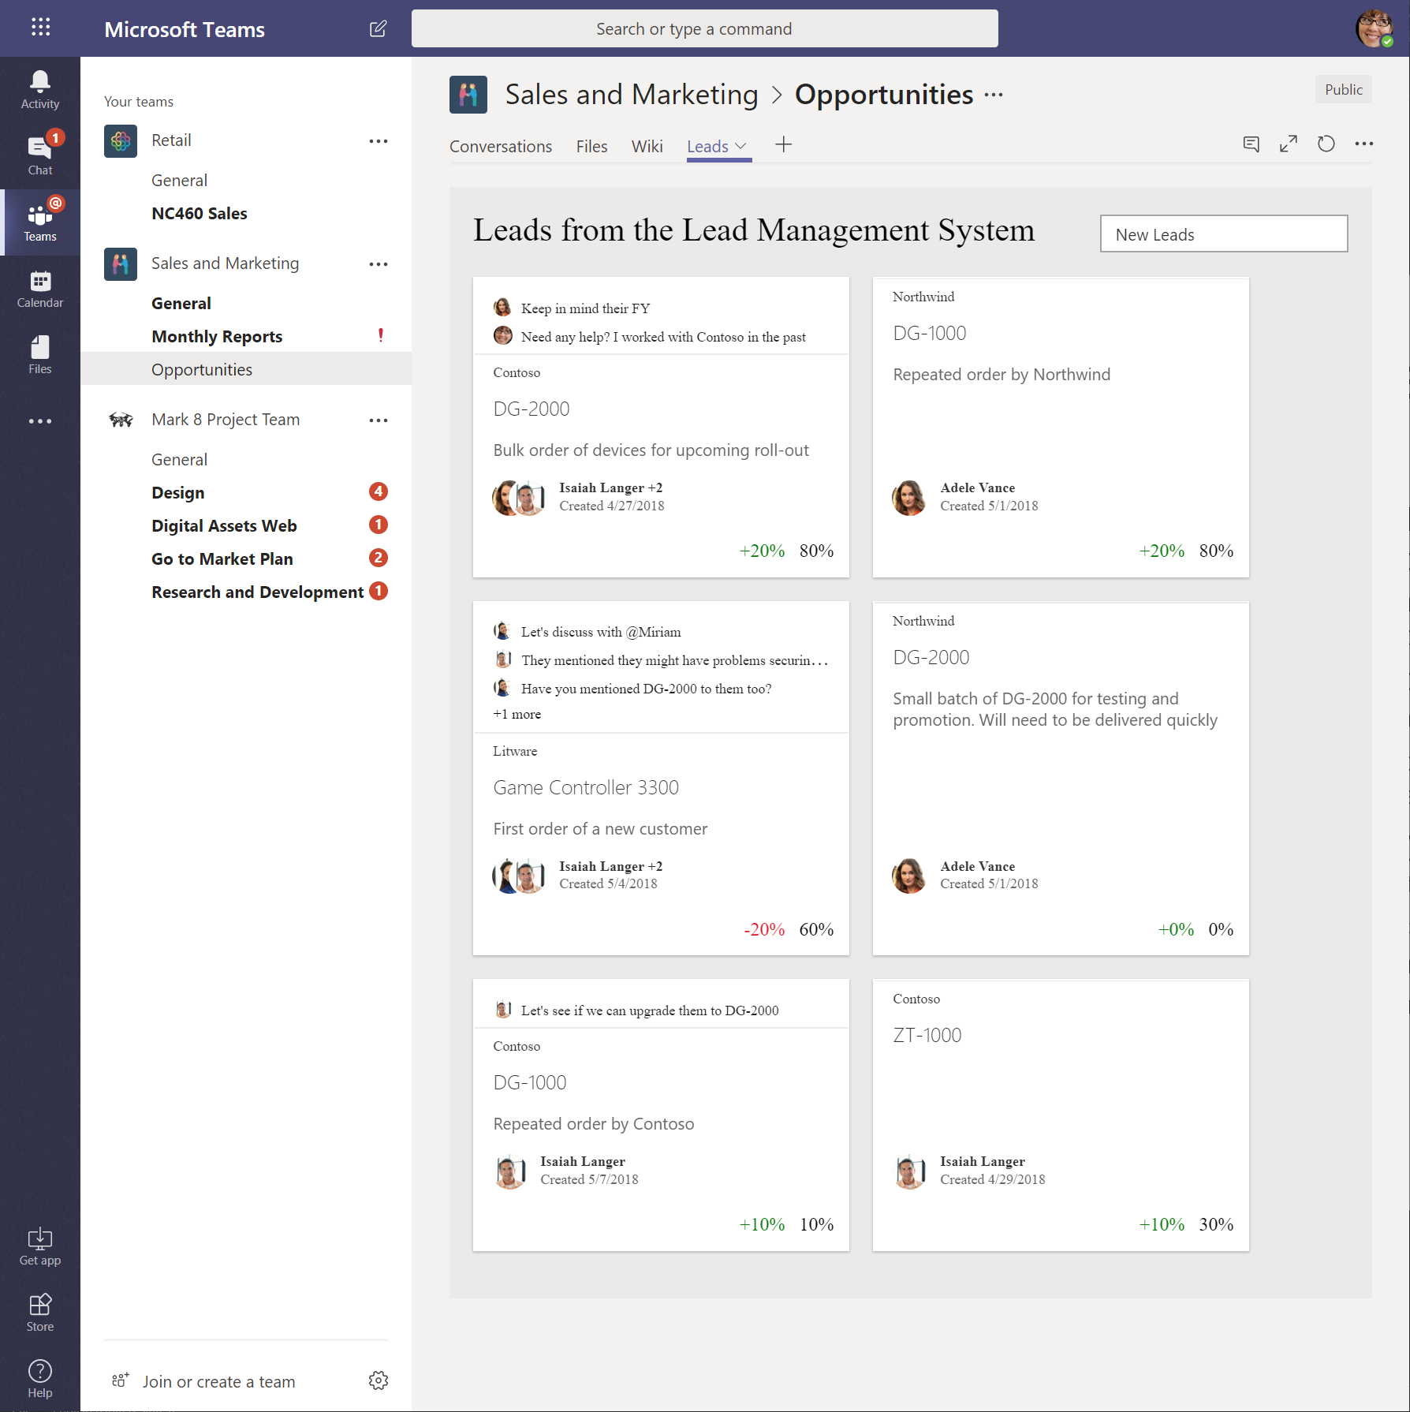
SharePoint Framework Hosted Scenarios
Classic Pages
Modern Pages
Lists and Libraries
App pages
Teams Tabs
Web Parts
Web Parts
Extensions
Web Parts
Web Parts
Extensions
Extensions
Library components work in all hosted platforms

Slide 10
Setup development Environment
SharePoint Framework is by default supported in SharePoint Server 2019, without any additional feature patch installations. Follow below steps to make your SP2019 environment ready for SPFx development.
Install NodeJS
Install version 8.x from https://nodejs.org
If you already have NodeJS installed, check the version
node -v
Install Code Editor
Visual Studio Code (https://code.visualstudio.com)
Install Yeoman and gulp
Run below command
npm install -g yo gulp
nstall Yeoman SharePoint Generator
SPFx version 1.4.1 is supported with SharePoint 2019 (except MS Graph APIs). Run below command.
npm install -g @microsoft/generator-sharepoint
Notes:
SharePoint Designer 2013 is the tool of choice for the rapid development of SharePoint applications. Please make sure your installation of SharePoint Designer is up to date by using Microsoft Update, or installing Service Pack 1

Slide 11
Learn Limitations
SharePoint 2019 supports SharePoint Framework v1.4.1 only

Slide 12
Develop Client Site webpart SPFx
yo @microsoft/sharepoint
Notes:
SharePoint Designer 2013 is the tool of choice for the rapid development of SharePoint applications. Please make sure your installation of SharePoint Designer is up to date by using Microsoft Update, or installing Service Pack 1

Slide 13
Deploy SPFx Webpart

